Slide 1
Baffling Integrals?

Slide 2



Baffling Integrals?
Evaluate the following integrals:
and
What do you notice? $\frac{1}{2}\ln{3}$
Can you explain your findings?
$$\int_{0.2}^{0.4}{\frac{5}{10x−1}dx}$$
$$\int_{3}^{6}{\frac{1}{2x−3}dx}$$

Slide 3

Baffling Integrals?
Evaluate the following integrals:
and
They both evaluate to $\frac{1}{2}\ln{3}$
Can you explain why?
$$\int_{0.2}^{0.4}{\frac{5}{10x−1}dx}$$
$$\int_{3}^{6}{\frac{1}{2x−3}dx}$$

Slide 4


Baffling Integrals?
A closer look at the integrals shows a pattern in the values used:
and
$$\int_{0.2}^{0.4}{\frac{5}{10x−1}dx}$$
$$\int_{0.2}^{0.4}{\frac{1}{2x−0.2}dx}$$
$$\int_{3}^{6}{\frac{1}{2x−3}dx}$$
$$×2$$
$$×2$$

Slide 5
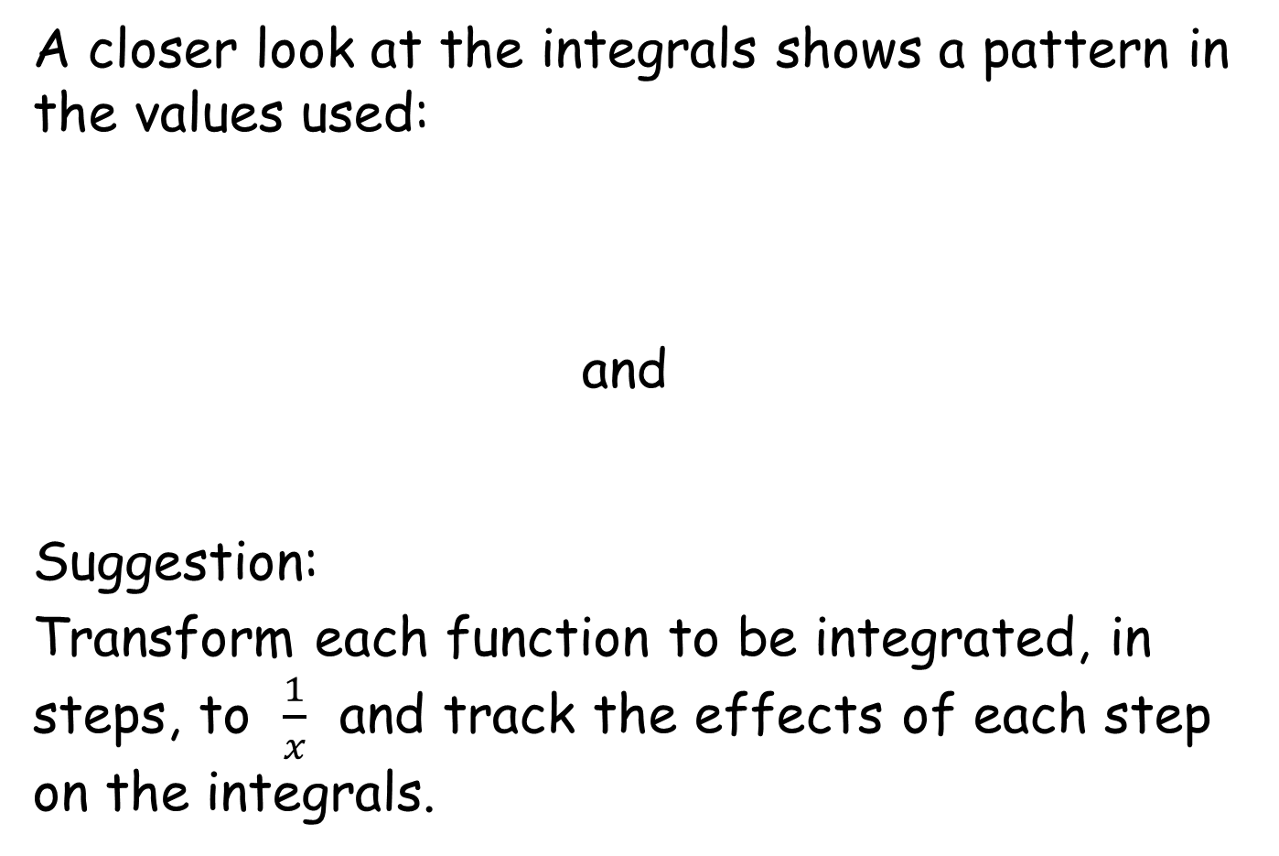
Baffling Integrals?
A closer look at the integrals shows a pattern in the values used:
and
Suggestion:
Transform each function to be integrated, in steps, to $\frac{1}{x}$ and track the effects of each step on the integrals.
$$\int_{0.2}^{0.4}{\frac{1}{2x−0.2}dx}$$
$$\int_{3}^{6}{\frac{1}{2x−3}dx}$$

Slide 6
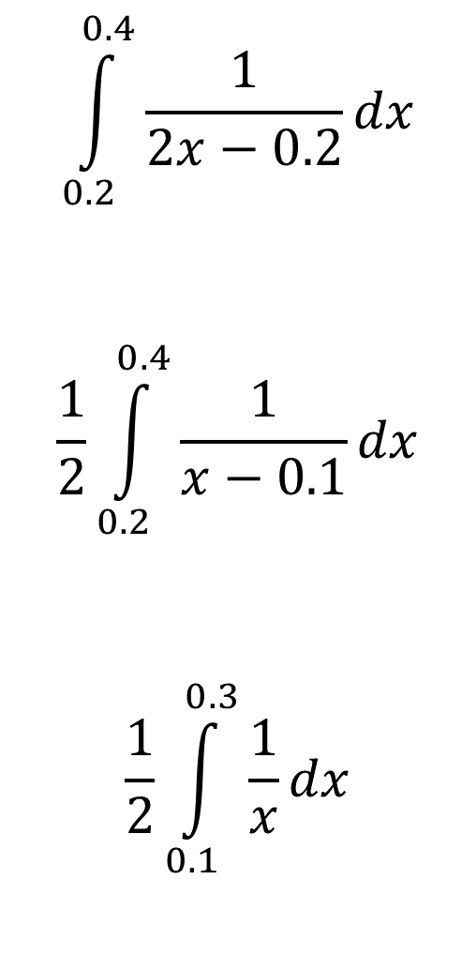

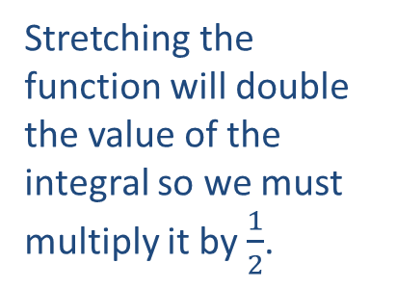
Baffling Integrals?
$$\int_{0.2}^{0.4}{\frac{1}{2x−0.2}dx}$$
$$\frac{1}{2}\int_{0.2}^{0.4}{\frac{1}{x−0.1}dx}$$
$$\frac{1}{2}\int_{0.1}^{0.3}{\frac{1}{x}dx}$$
$$\int_{3}^{6}{\frac{1}{2x−3}dx}$$
$$\frac{1}{2}\int_{3}^{6}{\frac{1}{x−1.5}dx}$$
$$\frac{1}{2}\int_{1.5}^{4.5}{\frac{1}{x}dx}$$
A stretch in the $y$-direction with scale factor $2$.
Stretching the function will double the value of the integral so we must multiply it by $\frac{1}{2}$.
A translation by $\left(\begin{matrix}−0.1 \\ 0\end{matrix}\right)$. A translation by $\left(\begin{matrix}−1.5 \\ 0\end{matrix}\right)$.
A translation of the function does not change the value of the integral.

Slide 7


Baffling Integrals?
$$\frac{1}{2}\int_{0.1}^{0.3}{\frac{1}{x}dx}$$
$$\frac{1}{2}\left[\begin{matrix} \\ \ln{x} \\ \end{matrix}\right]\begin{matrix}0.3 \\ \\ 0.1\end{matrix}$$
$$\frac{1}{2}\left(\ln{0.3}−\ln{0.1}\right)$$
$$\frac{1}{2}ln{3}$$
$$\frac{1}{2}\int_{1.5}^{4.5}{\frac{1}{x}dx}$$
$$\frac{1}{2}\left[\begin{matrix} \\ \ln{x} \\ \end{matrix}\right]\begin{matrix}4.5 \\ \\ 1.5\end{matrix}$$
$$\frac{1}{2}\left(\ln{4.5}−\ln{1.5}\right)$$
$$\frac{1}{2}\ln{3}$$
The same!

Slide 8
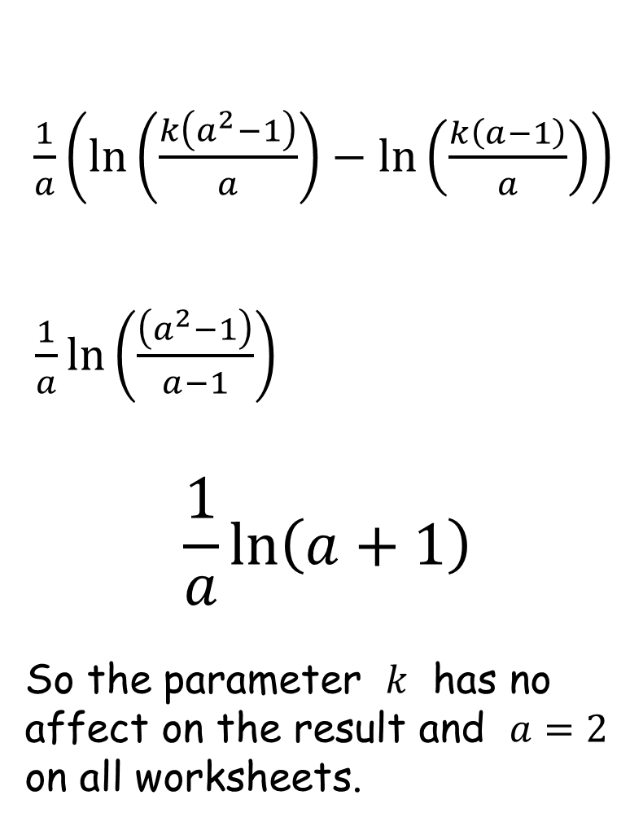
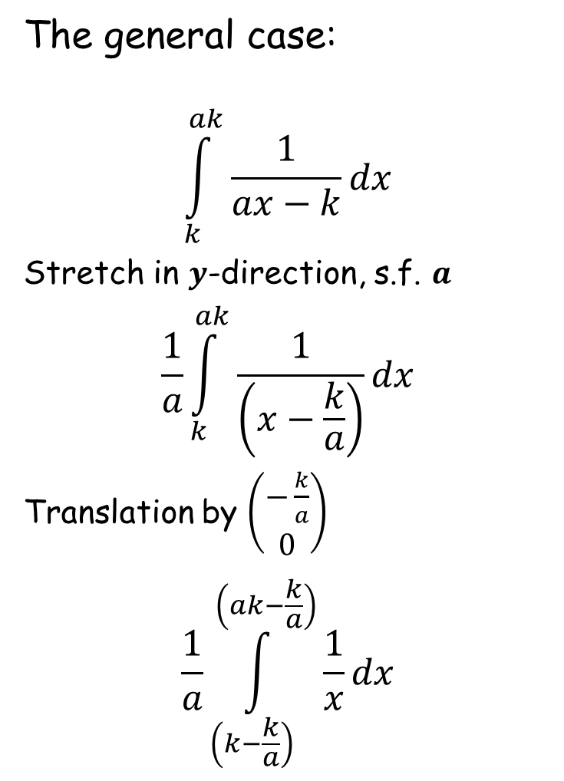
Baffling Integrals?
The general case:
$$\int_{k}^{ak}{\frac{1}{ax−k}dx}$$
Stretch in $y$-direction, s.f. $a$
$$\frac{1}{a}\int_{k}^{ak}{\frac{1}{\left(x−\frac{k}{a}\right)}dx}$$
Translation by $\left(\begin{matrix}−\frac{k}{a} \\ 0\end{matrix}\right)$
$$\frac{1}{a}\int_{\left(k−\frac{k}{a}\right)}^{\left(ak−\frac{k}{a}\right)}{\frac{1}{x}dx}$$
$\frac{1}{a}\left(\ln\left(\frac{k\left(a^{2}−1\right)}{a}\right)−\ln\left(\frac{k\left(a−1\right)}{a}\right)\right)$
$\frac{1}{a}\ln\left(\frac{\left(a^{2}−1\right)}{a−1}\right)$
$$\frac{1}{a}\ln\left(a+1\right)$$
So the parameter $k$ has no affect on the result and $a=2$ on all worksheets.

Slide 10
RESOURCES

Slide 11


Baffling Integrals?
SIC_76
Evaluate the following integrals:
and
What do you notice?
Can you explain your findings?
$$\int_{0.2}^{0.4}{\frac{5}{10x−1}dx}$$
$$\int_{3}^{6}{\frac{1}{2x−3}dx}$$
Notes:
A

Slide 12


Baffling Integrals?
SIC_76
Evaluate the following integrals:
and
What do you notice?
Can you explain your findings?
$$\int_{0.3}^{0.6}{\frac{10}{20x−3}dx}$$
$$\int_{1.75}^{3.5}{\frac{4}{8x−7}dx}$$
Notes:
B

Slide 13


Baffling Integrals?
SIC_76
Evaluate the following integrals:
and
What do you notice?
Can you explain your findings?
$$\int_{3.5}^{7}{\frac{2}{4x−7}dx}$$
$$\int_{2.2}^{4.4}{\frac{5}{10x−11}dx}$$
Notes:
C

Slide 14


Baffling Integrals?
SIC_76
Evaluate the following integrals:
and
What do you notice?
Can you explain your findings?
$$\int_{2.5}^{5}{\frac{2}{4x−5}dx}$$
$$\int_{1.8}^{3.6}{\frac{5}{10x−9}dx}$$
Notes:
D

Slide 15


Baffling Integrals?
SIC_76
Evaluate the following integrals:
and
What do you notice?
Can you explain your findings?
$$\int_{0.5}^{1}{\frac{2}{4x−1}dx}$$
$$\int_{2.6}^{5.2}{\frac{5}{10x−13}dx}$$
Notes:
E

Slide 16


Baffling Integrals?
SIC_76
Evaluate the following integrals:
and
What do you notice?
Can you explain your findings?
$$\int_{0.4}^{0.8}{\frac{5}{10x−2}dx}$$
$$\int_{0.25}^{0.5}{\frac{4}{8x−1}dx}$$
Notes:
F

Slide 17
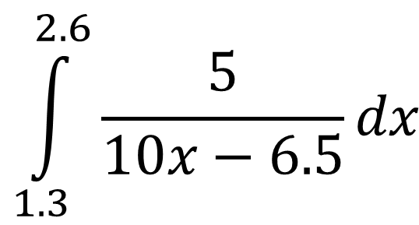

Baffling Integrals?
SIC_76
Evaluate the following integrals:
and
What do you notice?
Can you explain your findings?
$$\int_{4}^{8}{\frac{0.5}{x−2}dx}$$
$$\int_{1.3}^{2.6}{\frac{5}{10x−6.5}dx}$$
Notes:
G

Slide 18


Baffling Integrals?
SIC_76
Evaluate the following integrals:
and
What do you notice?
Can you explain your findings?
$$\int_{2}^{4}{\frac{0.5}{x−1}dx}$$
$$\int_{1.4}^{2.8}{\frac{5}{10x−7}dx}$$
Notes:
H

Slide 19


Baffling Integrals?
SIC_76
Evaluate the following integrals:
and
What do you notice?
Can you explain your findings?
$$\int_{0.8}^{1.6}{\frac{5}{10x−4}dx}$$
$$\int_{0.125}^{0.25}{\frac{8}{16x−1}dx}$$
Notes:
I

Slide 20



Baffling Integrals?
SIC_76
Evaluate the following integrals:
and
What do you notice?
Can you explain your findings?
$$\int_{0.6}^{1.2}{\frac{5}{10x−3}dx}$$
$$\int_{6}^{12}{\frac{1}{x−3}dx}$$
$$\frac{1}{2}$$
Notes:
J

Slide 21


Baffling Integrals?
SIC_76
Evaluate the following integrals:
and
What do you notice?
Can you explain your findings?
$$\int_{1.25}^{2.5}{\frac{4}{8x−5}dx}$$
$$\int_{1.2}^{2.4}{\frac{5}{10x−6}dx}$$
Notes:
K

Slide 22


Baffling Integrals?
SIC_76
Evaluate the following integrals:
and
What do you notice?
Can you explain your findings?
$$\int_{1.75}^{3.5}{\frac{4}{8x−7}dx}$$
$$\int_{\frac{5}{7}}^{\frac{10}{7}}{\frac{7}{14x−5}dx}$$
Notes:
L

